Slide 1
Dokumentasi
Rizal Bahrul ulum
Data engineer

Slide 2
Outline
Overview
Create View/Query
Create Store Procedure
Add Task/Step in Jobs
Existing View, SP, Table
Monitoring Data on Tableau Server

Slide 3
overview
Dokumen ini adalah dokumentasi pekerjaan saya sebagai Data Engineer di Departemen Big Data PT Pamapersada Nusantara.
Saya bertugas untuk men-support Usecase-E (SHE) dalam penyajian data yang siap digunakan untuk visualisasi. Dimana pekerjaan saya sering berubungan dengan pembuatan table/datamart, pembuatan schedule untuk update data, monitoring data, maintance/upadate query atau table.
Dokumen ini dibuat untuk memudahkan pembaca dalam memahami pekerjaan sebagai Data Engineer di PT Pamapersada Nusantara.

Slide 4
Create view/query
CREATE view [dbo].[view_satupamabi_highrisk_parameter_temuan_v2]
as
SELECT newid() AS pid
,pid_plan
,[tanggal]
,[dstrct_code]
,[temuan_lokasi_id]
,[temuan_keterangan_lokasi]
,[parameter_no]
,[kategori_temuan]
,[jenis_temuan]
,max([is_checked]) is_checked
,CASE WHEN [status] in ('Close','Complete','Validated') THEN 'Close' WHEN [status] in ('On Progress','Open') THEN 'Open' ELSE null END as status_grouped
-- ,sum(CASE WHEN [status] in ('Close','Complete','Validated') THEN 1 ELSE 0 END) as close_count
-- ,sum(CASE WHEN [status] in ('On Progress','Open') THEN 1 ELSE 0 END) as open_count
,CASE WHEN count(distinct [id_ticket]) = 0 THEN null ELSE count(distinct [id_ticket]) END as jumlah
,FUNCTIONAL_STRUCTURE
,POS_TITLE
,nrp_pic
,name_pic
FROM [dbo].satupamabi_highrisk_parameter_temuan_detail_v2
GROUP BY pid_plan
,[tanggal]
,[dstrct_code]
,[temuan_lokasi_id]
,[temuan_keterangan_lokasi]
,[parameter_no]
,[kategori_temuan]
,[jenis_temuan]
,CASE WHEN [status] in ('Close','Complete','Validated') THEN 'Close' WHEN [status] in ('On Progress','Open') THEN 'Open' ELSE null END
,FUNCTIONAL_STRUCTURE
,POS_TITLE
,nrp_pic
,name_pic
In SQL, a view is a virtual table based on the result-set of an SQL statement. A view contains rows and columns, just like a real table. The fields in a view are fields from one or more real tables in the database.
CREATE VIEW view_name AS SELECT column1, column2, ... FROM table_name WHERE condition;
*salahsatu contoh query pembentuk view yang ada di JIEPBDSQ402.DB_SATUMAPAMA_SHE.

Slide 5
Create Store Procedure
CREATE PROCEDURE [dbo].[cusp_satupamabi_highrisk_parameter_temuan_v2]
AS
DELETE [dbo].[satupamabi_highrisk_parameter_temuan_v2]
INSERT INTO [dbo].[satupamabi_highrisk_parameter_temuan_v2]
( pid, pid_plan,[tanggal]
,[dstrct_code]
,[temuan_lokasi_id]
,[temuan_keterangan_lokasi]
,[parameter_no]
,[kategori_temuan]
,[jenis_temuan]
,[is_checked]
,[status_grouped]
,[jumlah] , FUNCTIONAL_STRUCTURE , POS_TITLE, nrp_pic, name_pic
)
SELECT pid, pid_plan,[tanggal]
,[dstrct_code]
,[temuan_lokasi_id]
,[temuan_keterangan_lokasi]
,[parameter_no]
,[kategori_temuan]
,[jenis_temuan]
,[is_checked]
,[status_grouped]
,[jumlah],FUNCTIONAL_STRUCTURE ,POS_TITLE,nrp_pic ,name_pic
FROM [DB_SATUPAMA_SHE].[dbo].[view_satupamabi_highrisk_parameter_temuan_v2]
where tanggal>='2020-11-01'
A stored procedure is a prepared SQL code that you can save, so the code can be reused over and over again. So if you have an SQL query that you write over and over again, save it as a stored procedure, and then just call it to execute it.
CREATE PROCEDURE procedure_name AS sql_statement GO;
EXEC procedure_name;

Slide 6
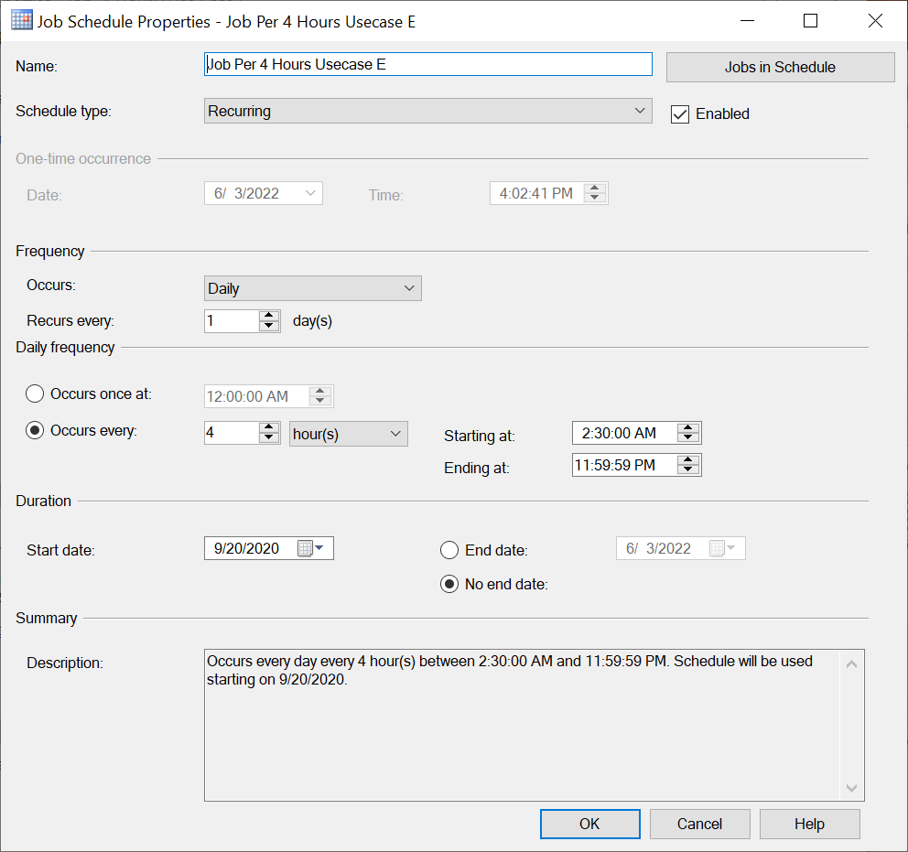
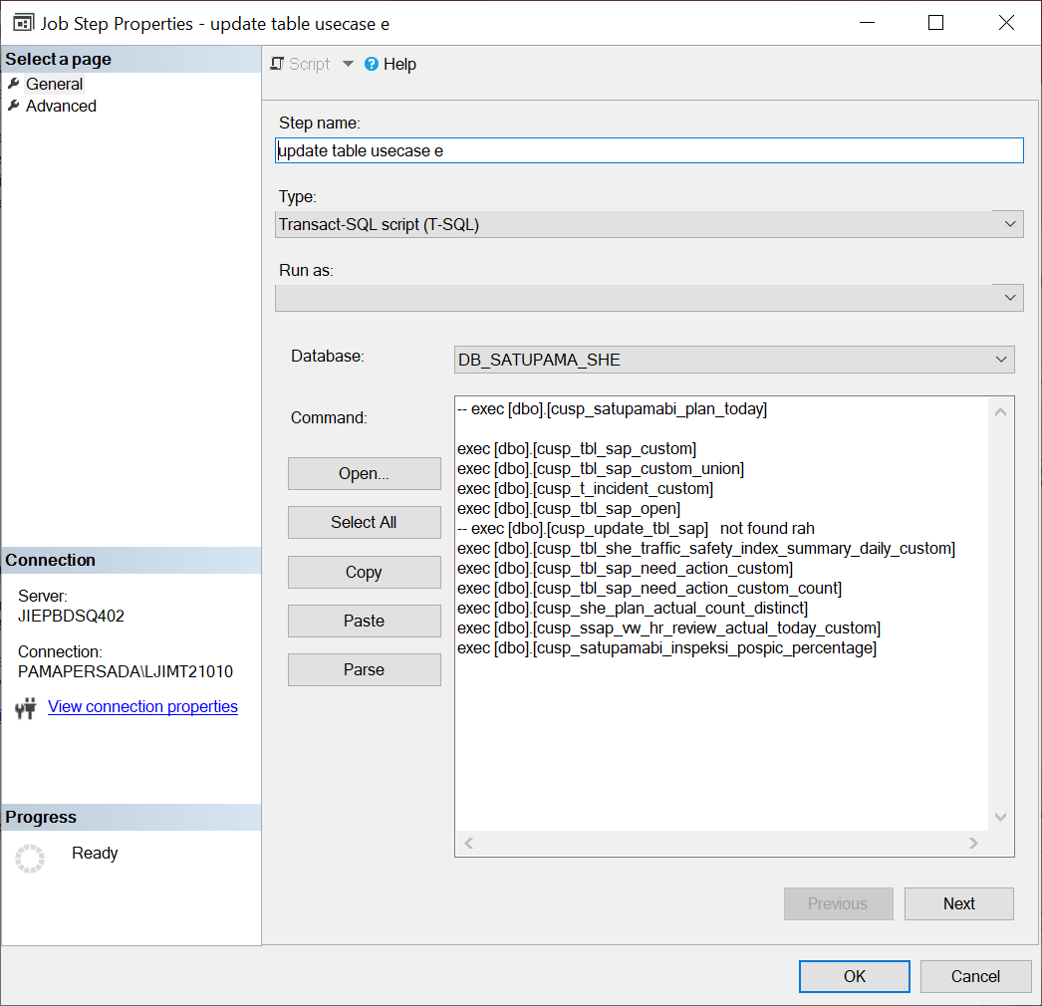
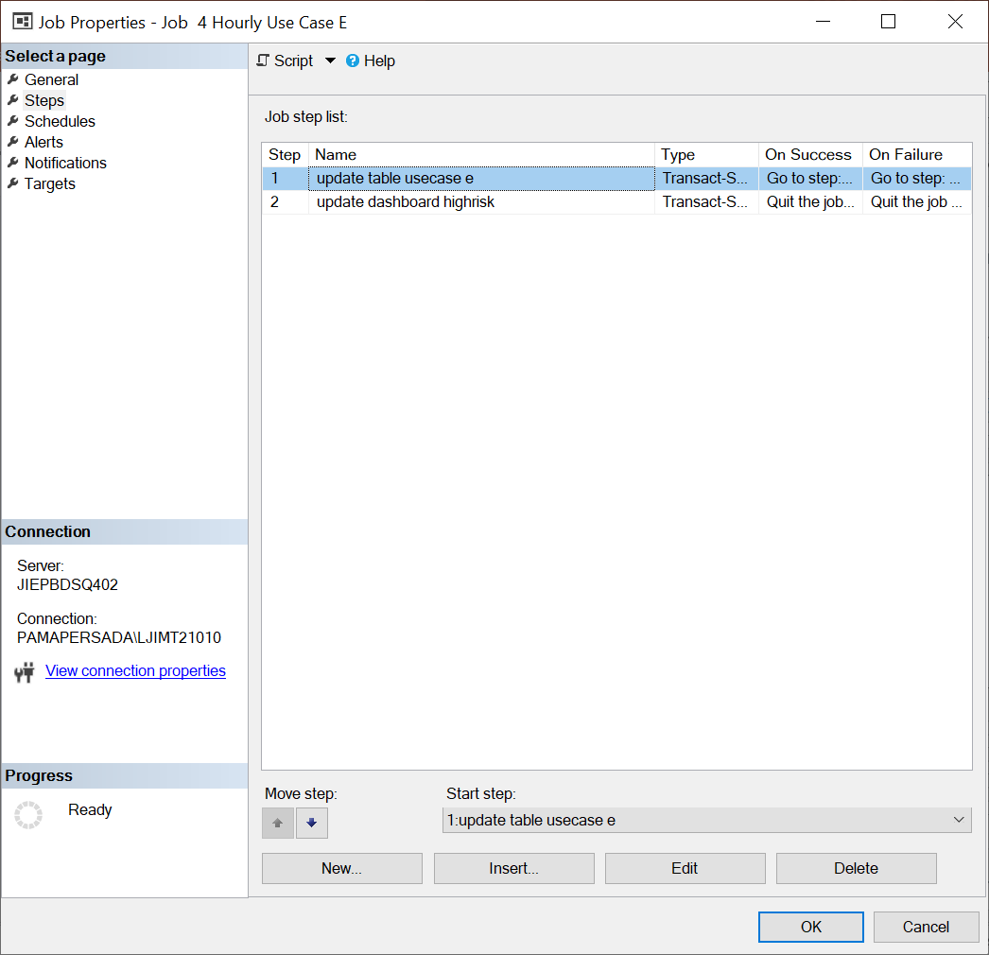
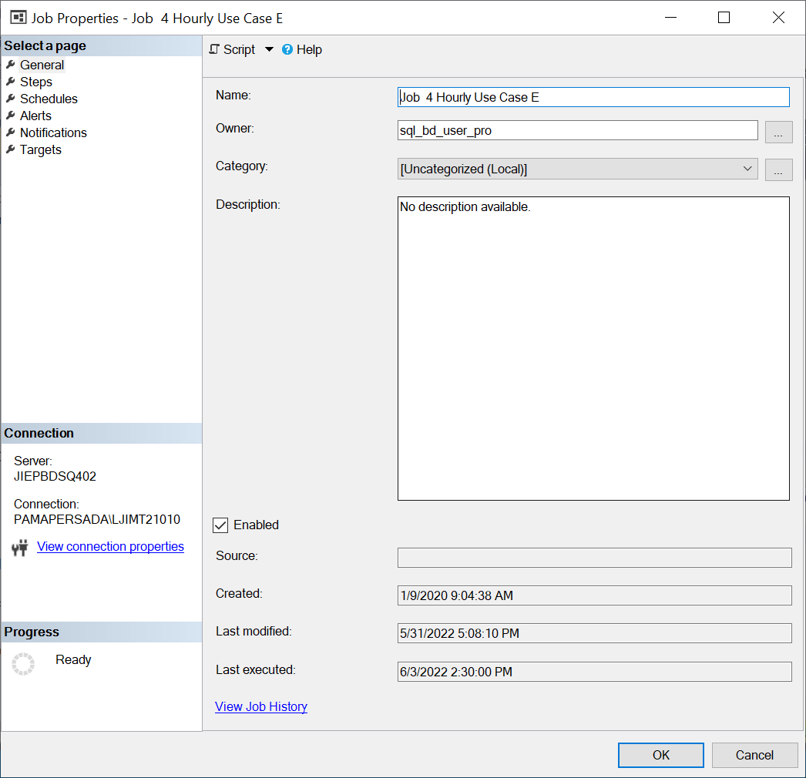
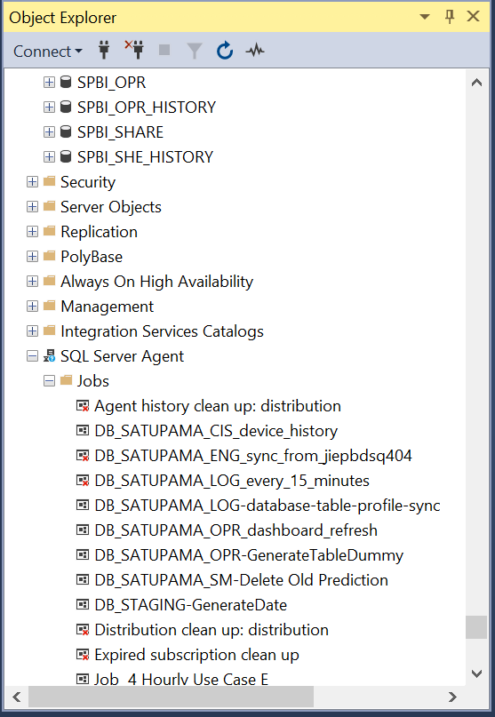
Add Step in Jobs

Slide 7
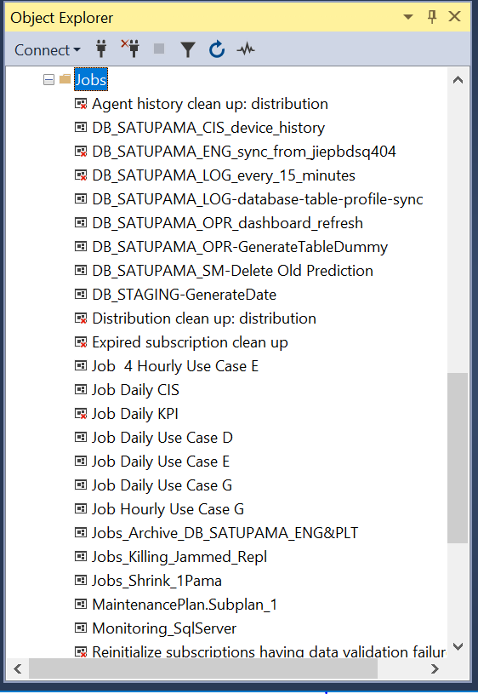

Slide 8
satupamabi_insiden_she_all_DE6_dash1
Column Name | Data Type
no_insiden | varchar(50)
dstrct_code | varchar(50)
tgl | date
jeniss_ | varchar(1000)
kode_fokus_program | varchar(50)
kode_bahaya | varchar(50)
status_insiden | varchar(50)
modified_date | datetime
isKorban | varchar(50)
nrp | varchar(50)
name | varchar(1000)
div_code | varchar(50)
FUNCTIONAL_STRUCTURE | varchar(4)
pic_nama_pica | varchar(100)
due_date_pica | date
pic_nrp_pica | varchar(50)
status_pica | varchar(50)
perbaikan_pica | varchar(8000)
div_code_pica | varchar(4)
dept_code_pica | varchar(4)
faktor_kritikal | varchar(8000)
kategori | varchar(100)
jenis_penyebab | varchar(8000)
lead_time | int
[DB_SATUPAMA_SHE_STG].[dbo].[tbl_t_insiden]
[DB_SATUPAMA_SHE_STG].[dbo].[tbl_t_insiden_pica]
[DB_SATUPAMA_SHE].[dbo].[tbl_dwh_employee]
[DB_SATUPAMA_SHE_STG].[dbo].[tbl_t_insiden_penyebab]
[DB_SATUPAMA_SHE_STG].[dbo].[tbl_t_insiden_alat]
[DB_SATUPAMA_SHE_STG].[dbo].[tbl_t_insiden_cidera]
[DB_SATUPAMA_SHE_STG].[dbo].[tbl_t_insiden_fakta]
[DB_SATUPAMA_SHE_STG].[dbo].[tbl_t_insiden_flow]
[DB_SATUPAMA_SHE_STG].[dbo].[tbl_t_insiden_pic_area]
[DB_SATUPAMA_SHE].[dbo].[tbl_dwh_employee]
[DB_SATUPAMA_SHE_STG].[dbo].[tbl_t_insiden_fokus_program]
CREATE VIEW
view_satupamabi_insiden_she_all_DE6_dash1
CREATE PROCEDURE
cusp_satupamabi_insiden_she_all_DE6_dash1
INSERT INTO TABLE
satupamabi_insiden_she_all_DE6_dash1

Slide 9
satupamabi_inspeksi_pospic_percentage
Column Name | Data Type
pid_plan | varchar(50)
id_ticket | varchar(100)
dstrct_code | varchar(4)
temuan_tanggal | datetime
temuan_jenis | varchar(50)
pembuat_pos_desc | varchar(100)
level_pos | varchar(12)
pos_pic | varchar(10)
temuan_kategori | varchar(200)
temuan_lokasi_id | varchar(100)
temuan_keterangan_lokasi | varchar(200)
created_by | varchar(10)
status | varchar(50)
is_complete | numeric(25, 13)
[is_PM&DPM] | numeric(25, 13)
is_dept_head | numeric(25, 13)
is_sect_head | numeric(25, 13)
is_group_leader | numeric(25, 13)
is_she | numeric(25, 13)
count_level_pos | int
PEMBUAT_NAMA | varchar(50)
nrp | varchar(10)
FUNCTIONAL_STRUCTURE | varchar(4)
flag_mic | int
percentage_gl | float
percentage_sh | float
percentage_she | float
percentage_dh | float
percentage_pm_dpm | float
durasi | int
parameter_frekuensi | int
jumlah_lokasiHR_approved | int
jumlah_lokasiHR_aktual | int
prioritas | int
dept_code | varchar(50)
[DB_SATUPAMA_SHE].[dbo].ssap_vw_hr_review_actual_today
[DB_SATUPAMA_SHE].[dbo].view_ssap_vw_hr_review_actual_today_MIC
[DB_SATUPAMA_SHE].[dbo].tbl_sap
[DB_STAGING].[dbo].[she_tbl_pos_level]
[DB_STAGING].[dbo].[TBL_DWH_EMPLOYEE]
[DB_SATUPAMA_SHE].[dbo].ssap_vw_hr_review_actual_today
[DB_SATUPAMA_SHE].[dbo].[satupamabi_highrisk_pos_pic_percentage_v2]
[DB_SATUPAMA_SHE].[dbo].[ssap_tbl_plan_highrisk]]
CREATE VIEW
view_satupamabi_inspeksi_pospic_percentage
CREATE PROCEDURE
cusp_satupamabi_inspeksi_pospic_percentage
INSERT INTO TABLE
satupamabi_inspeksi_pospic_percentage

Slide 10
satupamabi_highrisk_pos_pic_percentage_v2
Column Name | Data Type
pid_plan | varchar(50)
id_ticket | varchar(100)
dstrct_code | varchar(4)
temuan_tanggal | datetime
temuan_jenis | varchar(50)
pembuat_pos_desc | varchar(100)
level_pos | varchar(12)
pos_pic | varchar(10)
temuan_kategori | varchar(200)
temuan_lokasi_id | varchar(100)
temuan_keterangan_lokasi | varchar(200)
created_by | varchar(10)
status | varchar(50)
is_complete | numeric(25, 13)
[is_PM&DPM] | numeric(25, 13)
is_dept_head | numeric(25, 13)
is_sect_head | numeric(25, 13)
is_group_leader | numeric(25, 13)
is_she | numeric(25, 13)
count_level_pos | int
PEMBUAT_NAMA | varchar(50)
nrp | varchar(10)
FUNCTIONAL_STRUCTURE | varchar(4)
flag_mic | int
percentage_gl | float
percentage_sh | float
percentage_she | float
percentage_dh | float
percentage_pm_dpm | float
durasi | int
parameter_frekuensi | int
jumlah_lokasiHR_approved | int
jumlah_lokasiHR_aktual | int
prioritas | int
dept_code | varchar(50)
[DB_SATUPAMA_SHE].[dbo].[ssap_vw_hr_review_actual_today_custom]
[DB_SATUPAMA_SHE].[dbo].view_ssap_vw_hr_review_actual_today_MIC
[DB_SATUPAMA_SHE].[dbo].[ssap_vw_hr_review_plan_today]
[DB_SATUPAMA_SHE].[dbo].[ssap_tbl_t_hr_followup_pembatalan]
[DB_SATUPAMA_SHE].[dbo].[ssap_tbl_plan_highrisk]
[DB_STAGING].[dbo].[TBL_DWH_EMPLOYEE]
CREATE VIEW
view_satupamabi_highrisk_pos_pic_percentage_v2_BARU
CREATE PROCEDURE
cusp_satupamabi_highrisk_pos_pic_percentage_v2
INSERT INTO TABLE
satupamabi_highrisk_pos_pic_percentage_v2

Slide 11
satupamabi_highrisk_parameter_temuan_detail_v2
Column Name | Data Type
pid_plan | varchar(50)
id_ticket | varchar(100)
dstrct_code | varchar(4)
temuan_tanggal | datetime
temuan_jenis | varchar(50)
pembuat_pos_desc | varchar(100)
level_pos | varchar(12)
pos_pic | varchar(10)
temuan_kategori | varchar(200)
temuan_lokasi_id | varchar(100)
temuan_keterangan_lokasi | varchar(200)
created_by | varchar(10)
status | varchar(50)
is_complete | numeric(25, 13)
[is_PM&DPM] | numeric(25, 13)
is_dept_head | numeric(25, 13)
is_sect_head | numeric(25, 13)
is_group_leader | numeric(25, 13)
is_she | numeric(25, 13)
count_level_pos | int
PEMBUAT_NAMA | varchar(50)
nrp | varchar(10)
FUNCTIONAL_STRUCTURE | varchar(4)
flag_mic | int
percentage_gl | float
percentage_sh | float
percentage_she | float
percentage_dh | float
percentage_pm_dpm | float
durasi | int
parameter_frekuensi | int
jumlah_lokasiHR_approved | int
jumlah_lokasiHR_aktual | int
prioritas | int
dept_code | varchar(50)
[DB_SATUPAMA_SHE].[dbo].[ssap_vw_hr_review_actual_today]
[DB_SATUPAMA_SHE].[dbo].[ssap_vw_sap_mapping_lokasi]
[DB_SATUPAMA_SHE].[dbo].[ssap_tbl_plan_highrisk]
CREATE VIEW
view_satupamabi_highrisk_parameter_temuan_detail_v2
CREATE PROCEDURE
cusp_satupamabi_highrisk_parameter_temuan_detail_v2
INSERT INTO TABLE
satupamabi_highrisk_parameter_temuan_detail_v2

Slide 12
inspeksi_sap_percentage_v2
Column Name | Data Type
pid_plan | varchar(50)
id_ticket | varchar(100)
dstrct_code | varchar(4)
temuan_tanggal | datetime
temuan_jenis | varchar(50)
pembuat_pos_desc | varchar(100)
level_pos | varchar(12)
pos_pic | varchar(10)
temuan_kategori | varchar(200)
temuan_lokasi_id | varchar(100)
temuan_keterangan_lokasi | varchar(200)
created_by | varchar(10)
status | varchar(50)
is_complete | numeric(25, 13)
[is_PM&DPM] | numeric(25, 13)
is_dept_head | numeric(25, 13)
is_sect_head | numeric(25, 13)
is_group_leader | numeric(25, 13)
is_she | numeric(25, 13)
count_level_pos | int
PEMBUAT_NAMA | varchar(50)
nrp | varchar(10)
FUNCTIONAL_STRUCTURE | varchar(4)
flag_mic | int
percentage_gl | float
percentage_sh | float
percentage_she | float
percentage_dh | float
percentage_pm_dpm | float
durasi | int
parameter_frekuensi | int
jumlah_lokasiHR_approved | int
jumlah_lokasiHR_aktual | int
prioritas | int
dept_code | varchar(50)
[DB_SATUPAMA_SHE].[dbo].ssap_vw_hr_review_actual_today
[DB_SATUPAMA_SHE].[dbo].view_ssap_vw_hr_review_actual_today_MIC
[DB_SATUPAMA_SHE].[dbo].[ssap_vw_hr_review_plan_today]
[DB_STAGING].[dbo].[TBL_DWH_EMPLOYEE]
[DB_STAGING].[dbo].[she_tbl_pos_level]
[DB_SATUPAMA_SHE].[dbo].tbl_sap
CREATE VIEW
view_inspeksi_sap_percentage_v2_2
CREATE PROCEDURE
cusp_inspeksi_sap_percentage_v2
INSERT INTO TABLE
inspeksi_sap_percentage_v2

Slide 13
satupamabi_highrisk_summary_v3
Column Name | Data Type
pid | varchar(50)
dstrct_code | varchar(4)
temuan_lokasi_id | varchar(100)
temuan_keterangan_lokasi | varchar(100)
hr_lokasi | varchar(202)
activity | varchar(255)
tanggal | datetime
is_plan | int
is_actual | int
is_unplanned | int
cancel_sum | int
is_stopoperasi | int
status_stop_operasi | varchar(50)
duration | int
created_date_start_min | datetime
created_date_stop_max | datetime
user_notes | varchar(500)
temuan_kategori | varchar(500)
dept_in_charge | varchar(100)
FUNCTIONAL_STRUCTURE | varchar(4)
Terencana | varchar(3)
flag_hanging | int
flag_pos_title_SH | int
flag_actual | int
[DB_SATUPAMA_SHE].[dbo].[ssap_vw_hr_review_plan_today]
[DB_SATUPAMA_SHE].[dbo].[ssap_tbl_plan_highrisk]
[DB_STAGING].[dbo].[TBL_DWH_EMPLOYEE]
[DB_SATUPAMA_SHE].[dbo].[satupamabi_highrisk_start_stop_v2]
CREATE VIEW
view_satupamabi_highrisk_summary_v3_2
CREATE PROCEDURE
cusp_satupamabi_highrisk_summary_v3
INSERT INTO TABLE
satupamabi_highrisk_summary_v3

Slide 14
satupamabi_highrisk_start_stop_v2
Column Name | Data Type
pid | varchar(50)
pid_hr | varchar(50)
[Dstrct Code] | varchar(4)
jenis_temuan | varchar(50)
[Temuan Kategori] | varchar(500)
[Temuan Lokasi Id] | varchar(100)
temuan_keterangan_lokasi | varchar(100)
[Temuan Tanggal] | datetime
activity | varchar(255)
id_ticket | varchar(100)
nrp_pic | varchar(10)
status | varchar(50)
pembuat_pos_desc | int
pembuat_dept_desc | int
pembuat_nama | varchar(50)
[LANJUT Operasi] | datetime
[STOP Operasi] | datetime
duration | int
FUNCTIONAL_STRUCTURE | varchar(4)
Deskrpsi_Temuan | varchar(255)
Perbaikan | varchar(255)
lead_time | int
[DB_SATUPAMA_SHE].[dbo].[ssap_vw_hr_history_operasi]
[DB_SATUPAMA_SHE].[dbo].[ssap_tbl_plan_highrisk]
[DB_STAGING].[dbo].[TBL_DWH_EMPLOYEE]
CREATE VIEW
view_satupamabi_highrisk_start_stop_v2
CREATE PROCEDURE
cusp_satupamabi_highrisk_start_stop_v2
INSERT INTO TABLE
satupamabi_highrisk_start_stop_v2

Slide 15
tbl_t_incident_custom
Column Name | Data Type
pid | varchar(50)
pid_hr | varchar(50)
[Dstrct Code] | varchar(4)
jenis_temuan | varchar(50)
[Temuan Kategori] | varchar(500)
[Temuan Lokasi Id] | varchar(100)
temuan_keterangan_lokasi | varchar(100)
[Temuan Tanggal] | datetime
activity | varchar(255)
id_ticket | varchar(100)
nrp_pic | varchar(10)
status | varchar(50)
pembuat_pos_desc | int
pembuat_dept_desc | int
pembuat_nama | varchar(50)
[LANJUT Operasi] | datetime
[STOP Operasi] | datetime
duration | int
FUNCTIONAL_STRUCTURE | varchar(4)
Deskrpsi_Temuan | varchar(255)
Perbaikan | varchar(255)
lead_time | int
[DB_SATUPAMA_SHE].[dbo].[tbl_t_incident]
[DB_SATUPAMA_SHE].[dbo].[tbl_koordinat]
jiepbdsq401.[DB_SHE_DEVL].[dbo].[tbl_insiden_join_lpi]
[DB_STAGING].[dbo].[she_threshold]
[DB_STAGING].[dbo].[she_all_employee]
CREATE VIEW
view_tbl_t_incident_custom
CREATE PROCEDURE
cusp_tbl_t_incident_custom
INSERT INTO TABLE
tbl_t_incident_custom

Slide 16
tbl_sap_custom_highrisk
Column Name | Data Type | Deskripsi
id_ticket | varchar(50)
dstrct_code | varchar(6)
bulan | varchar(2)
temuan_tanggal | date
temuan_jenis | varchar(19)
temuan_deskripsi | varchar(1000)
temuan_kode_bahaya | varchar(2)
temuan_kategori | varchar(500)
temuan_overdue | int
temuan_lokasi_id | varchar(105)
temuan_keterangan_lokasi | varchar(50)
status | varchar(12)
created_by | varchar(100)
created_date | datetime
name | varchar(255)
perbaikan_deskripsi | varchar(200)
perbaikan_tanggal | date
perbaikan_jam | varchar(10)
perbaikan_date | datetime
div_code_desc | varchar(255)
dept_code | varchar(255)
functional_structure | varchar(6)
pos_title | varchar(255)
temuan_pelaku_nrp | varchar(50)
temuan_pelaku_titel | varchar(255)
temuan_pelaku_nama | varchar(255)
APPROVAL_DATE | datetime
temuan_pic_dept | varchar(6)
pic_nrp | varchar(10)
PERBAIKAN_NAMA | varchar(100)
APPROVAL_NAMA | varchar(100)
APPROVAL_POS_DESC | varchar(100)
PERBAIKAN_POS_DESC | varchar(100)
PERBAIKAN_DEPT_DESC | varchar(100)
PELAKU_POS_DESC | varchar(100)
PEMBUAT_POS_DESC | varchar(100)
activity | varchar(255)
JENIS_AKTIFITAS | varchar(50)
[DB_STAGING].[dbo].[she_all_employee]
[DB_SATUPAMA_SHE].[dbo].[tbl_sap]
[DB_SATUPAMA_SHE].[dbo].[ssap_vw_hr_review_actual_today]
CREATE VIEW
view_tbl_sap_custom_highrisk
CREATE PROCEDURE
cusp_tbl_sap_custom_highrisk
INSERT INTO TABLE
tbl_sap_custom_highrisk

Slide 17
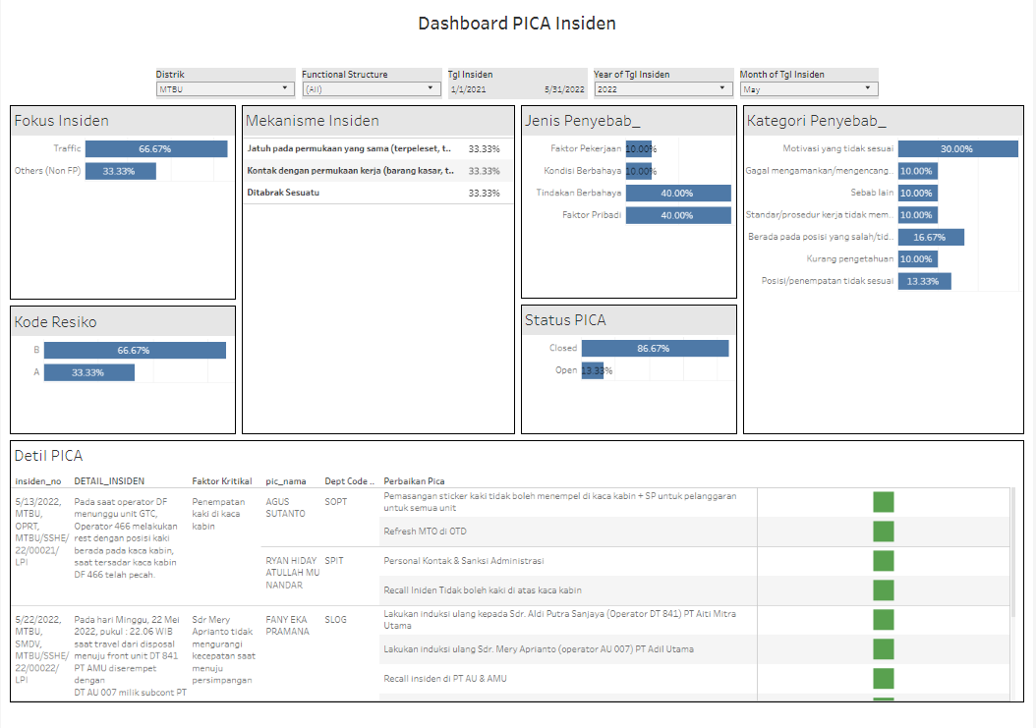
satupamabi_insiden_she_all_DE6_dash1
Column Name | Data Type
no_insiden | varchar(50)
dstrct_code | varchar(50)
tgl | date
jeniss_ | varchar(1000)
kode_fokus_program | varchar(50)
kode_bahaya | varchar(50)
status_insiden | varchar(50)
modified_date | datetime
isKorban | varchar(50)
nrp | varchar(50)
name | varchar(1000)
div_code | varchar(50)
FUNCTIONAL_STRUCTURE | varchar(4)
pic_nama_pica | varchar(100)
due_date_pica | date
pic_nrp_pica | varchar(50)
status_pica | varchar(50)
perbaikan_pica | varchar(8000)
div_code_pica | varchar(4)
dept_code_pica | varchar(4)
faktor_kritikal | varchar(8000)
kategori | varchar(100)
jenis_penyebab | varchar(8000)
lead_time | int
Tabel ini
http://jieptbco402/#/views/DE6DashboardSHEStatistik-Newv_1_4_1_16383317789220/Dashboard1?:iid=2

Slide 18
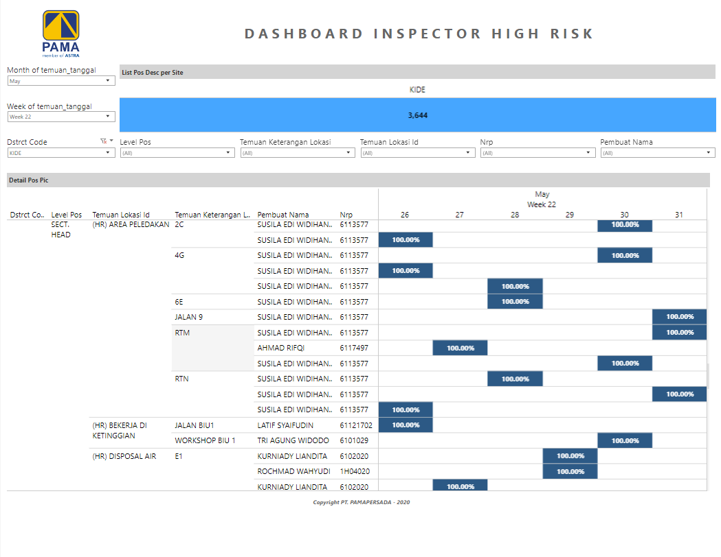
Column Name | Data Type | Deskripsi
pid_plan | varchar(50)
id_ticket | varchar(100)
dstrct_code | varchar(4)
temuan_tanggal | datetime
temuan_jenis | varchar(50)
pembuat_pos_desc | varchar(100)
level_pos | varchar(12)
pos_pic | varchar(10)
temuan_kategori | varchar(200)
temuan_lokasi_id | varchar(100)
temuan_keterangan_lokasi | varchar(200)
created_by | varchar(10)
status | varchar(50)
is_complete | numeric(25, 13)
[is_PM&DPM] | numeric(25, 13)
is_dept_head | numeric(25, 13)
is_sect_head | numeric(25, 13)
is_group_leader | numeric(25, 13)
is_she | numeric(25, 13)
count_level_pos | int
PEMBUAT_NAMA | varchar(50)
nrp | varchar(10)
FUNCTIONAL_STRUCTURE | varchar(4)
flag_mic | int
percentage_gl | float
percentage_sh | float
percentage_she | float
percentage_dh | float
percentage_pm_dpm | float
durasi | int
parameter_frekuensi | int
jumlah_lokasiHR_approved | int
jumlah_lokasiHR_aktual | int
prioritas | int
dept_code | varchar(50)
satupamabi_inspeksi_pospic_percentage
http://jieptbco402/#/views/DE12DashboardPlanningSAPHighRisk/DashboardInspectorHighRisk2?:iid=1

Slide 19
Column Name | Data Type | Deskripsi
pid | uniqueidentifier
pid_plan | varchar(50)
tanggal | date
dstrct_code | varchar(4)
temuan_lokasi_id | varchar(100)
activity | varchar(255)
temuan_keterangan_lokasi | varchar(100)
dept_in_charge | varchar(100)
pos_pic | varchar(10)
jam_followup | int
durasi | int
frekuensi | int
parameter_frekuensi | int
percentage_gl | float
percentage_sh | float
percentage_she | float
percentage_dh | float
percentage_pm_dpm | float
FUNCTIONAL_STRUCTURE | varchar(4)
rank | bigint
flag_mic | int
percentage_pm_dpm_ubahan | float
satupamabi_highrisk_pos_pic_percentage_v2

Slide 20
Column Name | Data Type | Deskripsi
pid | varchar(50)
pid_plan | varchar(50)
tanggal | date
dstrct_code | varchar(4)
temuan_lokasi_id | varchar(100)
temuan_keterangan_lokasi | varchar(100)
nama_pembuat | varchar(50)
parameter_no | int
kategori_temuan | varchar(500)
jenis_temuan | varchar(50)
is_checked | int
status | varchar(50)
id_ticket | varchar(100)
temuan_deskripsi | int
FUNCTIONAL_STRUCTURE | varchar(4)
POS_TITLE | varchar(40)
nrp_pic | varchar(10)
name_pic | varchar(50)
satupamabi_highrisk_parameter_temuan_detail_v2

Slide 21
Column Name | Data Type | Deskripsi
id_ticket | varchar(100)
dstrct_code | varchar(6)
temuan_tanggal | date
temuan_jenis | varchar(50)
pembuat_pos_desc | varchar(100)
level_pos | varchar(255)
temuan_kategori | varchar(500)
temuan_lokasi_id | varchar(100)
temuan_keterangan_lokasi | varchar(50)
created_by | varchar(100)
status | varchar(50)
is_complete | float
[is_PM&DPM] | float
is_dept_head | float
is_sect_head | float
is_group_leader | float
is_she | float
count_level_pos | int
PEMBUAT_NAMA | varchar(100)
nrp | varchar(100)
FUNCTIONAL_STRUCTURE | varchar(4)
flag_mic | varchar(2)

Slide 22
Column Name | Data Type | Deskripsi
pid | varchar(50)
dstrct_code | varchar(4)
temuan_lokasi_id | varchar(100)
temuan_keterangan_lokasi | varchar(100)
hr_lokasi | varchar(202)
activity | varchar(255)
tanggal | datetime
is_plan | int
is_actual | int
is_unplanned | int
cancel_sum | int
is_stopoperasi | int
status_stop_operasi | varchar(50)
duration | int
created_date_start_min | datetime
created_date_stop_max | datetime
user_notes | varchar(500)
temuan_kategori | varchar(500)
dept_in_charge | varchar(100)
FUNCTIONAL_STRUCTURE | varchar(4)
Terencana | varchar(3)
flag_hanging | int
flag_pos_title_SH | int
flag_actual | int
satupamabi_highrisk_summary_v3

Slide 23
Column Name | Data Type | Deskripsi
pid | varchar(50)
pid_hr | varchar(50)
[Dstrct Code] | varchar(4)
jenis_temuan | varchar(50)
[Temuan Kategori] | varchar(500)
[Temuan Lokasi Id] | varchar(100)
temuan_keterangan_lokasi | varchar(100)
[Temuan Tanggal] | datetime
activity | varchar(255)
id_ticket | varchar(100)
nrp_pic | varchar(10)
status | varchar(50)
pembuat_pos_desc | int
pembuat_dept_desc | int
pembuat_nama | varchar(50)
[LANJUT Operasi] | datetime
[STOP Operasi] | datetime
duration | int
FUNCTIONAL_STRUCTURE | varchar(4)
Deskrpsi_Temuan | varchar(255)
Perbaikan | varchar(255)
lead_time | int
satupamabi_highrisk_start_stop_v2

Slide 24
Column Name | Data Type | Deskripsi
PID | varchar(50)
DISTRIK | varchar(50)
TGL_INSIDEN | date
BULAN | int
DETAIL_INSIDEN | varchar(MAX)
KATEGORI | varchar(50)
DIVISI | varchar(50)
DEPARTEMEN | varchar(100)
JABATAN | varchar(50)
NRP | varchar(50)
NAMA_PELAKU_KORBAN | varchar(1000)
LAMA_MENJABAT | varchar(50)
NAMA_GL | varchar(100)
PF_NPF | varchar(45)
KODE_KLARISIFIKASI_INSIDEN | varchar(50)
WAKTU | varchar(45)
LOKASI | varchar(1000)
KODE_FOKUS_PROGRAM | varchar(50)
TINDAKAN_BERBAHAYA | varchar(2000)
KONDISI_BERBAHAYA | varchar(2000)
FAKTOR_PRIBADI | varchar(8000)
FAKTOR_PEKERJAAN | varchar(8000)
PICA | varchar(2000)
MOD_DATE | datetime
MOD_BY | varchar(100)
TEMUAN_JENIS | varchar(2000)
FIRE_INCIDENT | int
FATIGUE_INCIDENT | int
[H&F_INCIDENT] | int
SLIDING_INCIDENT | int
OTHERS_INCIDENT | int
TRAFFIC_INCIDENT_ONLY | int
FATAL | int
LTI | int
MI | int
PD | int
latitude | float
longitude | float
Threshold | int
JENIS_INSIDEN | varchar(1000)
dept_code | varchar(50)
TH_NONTH | varchar(255)
flag_insiden | int
insiden_no | varchar(255)
lpi_id | varchar(255)
nama_file | varchar(225)
path_file | varchar(1044)
status_insiden_lpi | varchar(50)
tbl_t_incident_custom

Slide 25
Column Name | Data Type | Deskripsi
id_ticket | varchar(50)
dstrct_code | varchar(6)
bulan | varchar(2)
temuan_tanggal | date
temuan_jenis | varchar(19)
temuan_deskripsi | varchar(1000)
temuan_kode_bahaya | varchar(2)
temuan_kategori | varchar(500)
temuan_overdue | int
temuan_lokasi_id | varchar(105)
temuan_keterangan_lokasi | varchar(50)
status | varchar(12)
created_by | varchar(100)
created_date | datetime
name | varchar(255)
perbaikan_deskripsi | varchar(200)
perbaikan_tanggal | date
perbaikan_jam | varchar(10)
perbaikan_date | datetime
div_code_desc | varchar(255)
dept_code | varchar(255)
functional_structure | varchar(6)
pos_title | varchar(255)
temuan_pelaku_nrp | varchar(50)
temuan_pelaku_titel | varchar(255)
temuan_pelaku_nama | varchar(255)
APPROVAL_DATE | datetime
temuan_pic_dept | varchar(6)
pic_nrp | varchar(10)
PERBAIKAN_NAMA | varchar(100)
APPROVAL_NAMA | varchar(100)
APPROVAL_POS_DESC | varchar(100)
PERBAIKAN_POS_DESC | varchar(100)
PERBAIKAN_DEPT_DESC | varchar(100)
PELAKU_POS_DESC | varchar(100)
PEMBUAT_POS_DESC | varchar(100)
activity | varchar(255)
JENIS_AKTIFITAS | varchar(50)
tbl_sap_custom_highrisk

